Slide 1
DiabLLM
An LLM-Based Framework for Blood Glucose Prediction in Type 1 Diabetes
Amirhossein Mahmoudi | First author and presenter
IEEE Journal of Biomedical and Health Informatics • 2026
TIME-LLM
CHRONOS
CGM FORECASTING
DOI 10.1109/JBHI.2026.3658588
Notes:
Open with the core idea: this work asks whether language-inspired forecasting architectures can model short-term glucose dynamics from CGM alone. Introduce yourself as Amirhossein Mahmoudi, first author. The talk has three parts: architectural choices, evidence, and what remains before deployment.

Slide 2
CLINICAL FORECASTING PROBLEM
Thirty minutes of CGM history must anticipate the next 30-45 minutes
PAST
FORECAST
NOW
6 readings
5-minute sampling
6 or 9 targets
30- or 45-minute horizon
Source: DiabLLM abstract and experimental protocol. Illustrative glucose trajectory; not patient data.
Notes:
The operational task is deliberately constrained: six CGM readings, covering only thirty minutes, must generate six or nine future values. Explain why this matters: short context limits feature engineering, while longer horizons amplify uncertainty. The illustrated trajectory is schematic, not a patient record. Transition: the key design question is how to make language-model machinery accept continuous glucose.

Slide 3
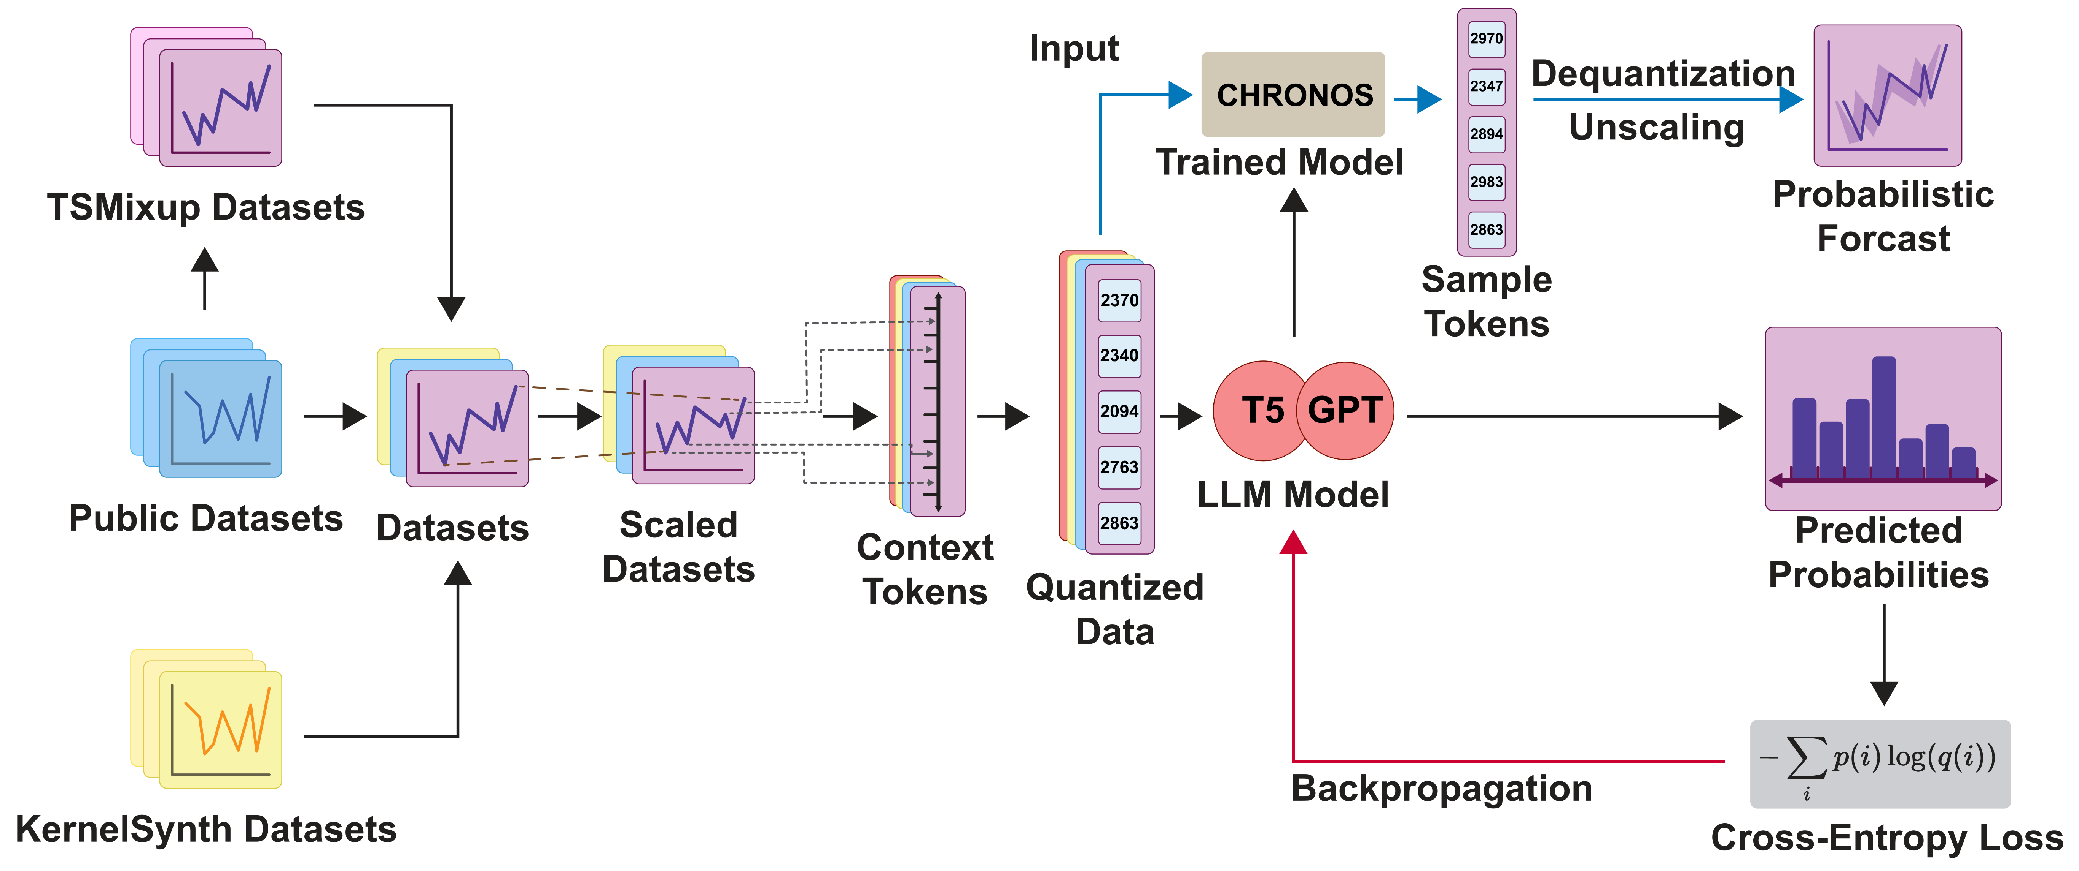
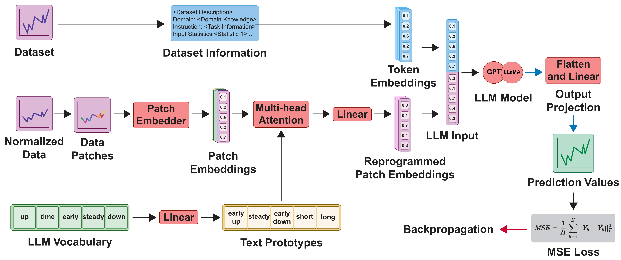
TWO LANGUAGE-INSPIRED STRATEGIES
Chronos and Time-LLM bridge continuous signals in fundamentally different ways
CHRONOS
TIME-LLM
scale
quantize
predict tokens
patch
reprogram
frozen LLM
Regression via classification
Modality alignment
The transformer is trained on a time-series vocabulary.
Lightweight layers map patches into the LLM embedding space.
Sources: Ansari et al., Chronos, arXiv:2403.07815; Jin et al., Time-LLM, arXiv:2310.01728; DiabLLM methodology.
Notes:
Chronos discretizes the values and trains a language-model architecture to predict the next token. Time-LLM keeps a pretrained language model frozen and learns how to reprogram numerical patches into its embedding space, adding a textual prompt with dataset and input statistics. Emphasize that both are called language-inspired, but only Time-LLM reuses a frozen general-purpose language backbone in this implementation.

Slide 4
STUDY DESIGN
DiabLLM evaluates adaptation, robustness, transfer, and compression
1
2
3
4
5
Forecast
Stress
Transfer
Compress
Assess
Zero-shot and personalized fine-tuning
Noise, calibration bias, and missing CGM
Cross-patient evaluation
BERT teacher to TinyBERT student
RMSE, MAE, CEG, SEG, and efficiency
The contribution is the complete evidence chain - not a single leaderboard number.
Source: DiabLLM methodology and experimental sections.
Notes:
Frame the paper as a structured evaluation. It begins with forecasting, then tests the effect of adaptation, realistic corruption, patient transfer, model compression, and clinical error grids. This helps the audience understand why the later slides are organized as an evidence chain rather than a catalogue of experiments.

Slide 5
DATA AND PROTOCOL
Two public T1DM cohorts test personalization and external transfer
OhioT1DM
D1NAMO
12
8
5
9
7
4
adults
weeks
minutes
people
used
weeks
with T1DM
per cohort record
CGM sampling
in the dataset
patients 1-7
collection period
Primary personalized and cross-patient evaluation
Complementary validation cohort
Predefined train/test sets; missing values preserved in the core protocol.
Used to test whether the adaptation pattern extends beyond OhioT1DM.
Source: DiabLLM experiments. OhioT1DM: Marling and Bunescu (2020); D1NAMO: Dubosson et al. (2018).
Notes:
Describe the evidence base without overselling scale. OhioT1DM is the main cohort: twelve adults, eight weeks, sampled every five minutes. D1NAMO is a complementary cohort; seven of nine individuals are used. The study is retrospective and public-data based. Transition to the central experimental finding: adaptation matters more than model size alone.

Slide 6
ZERO-SHOT VERSUS FINE-TUNED
Task-specific adaptation produces the largest accuracy gain
RMSE reduction after adaptation
34%
6%
Time-LLM
Chronos
Same 30-minute history and 30-minute horizon
Fine-tuning the modality bridge is more consequential than simply selecting a larger pretrained model.
Sources: DiabLLM Tables: zero-shot and fine-tuned 30-minute results. Percentages calculated from table averages.
Notes:
At the same thirty-minute horizon, Time-LLM LLaMA 8-layer moves from 24.44 to 16.10 RMSE, while Chronos Base moves from 22.29 to 20.89. The exact percentage differs slightly from the manuscript narrative because this slide computes directly from the table averages. The point is not that zero-shot fails; it is that clinical-domain adaptation is decisive.

Slide 7
30-MINUTE OHIOT1DM BENCHMARK
Fine-tuned Time-LLM reaches 16.10 mg/dL average RMSE
What the comparison supports
1
Time-LLM variants cluster near 16 mg/dL RMSE.
2
LLaMA-8 improves 12.1% over the matched Deep RL baseline.
3
Chronos offers a smaller accuracy gain with faster fine-tuning.
Caution
Rows from other papers are contextual unless the protocol is explicitly matched.
Source: DiabLLM Table: Model Performance Comparison (30-minute history and horizon). Lower RMSE is better.
Notes:
Lead with the absolute result: 16.10 milligrams per deciliter average RMSE for the fine-tuned LLaMA 8-layer Time-LLM. The directly comparable Deep RL and fusion baselines are 18.32 and 21.90. State the caveat visibly: the full article table contains other studies with differing protocols, so this slide selects the comparisons the manuscript identifies as matched.

Slide 8
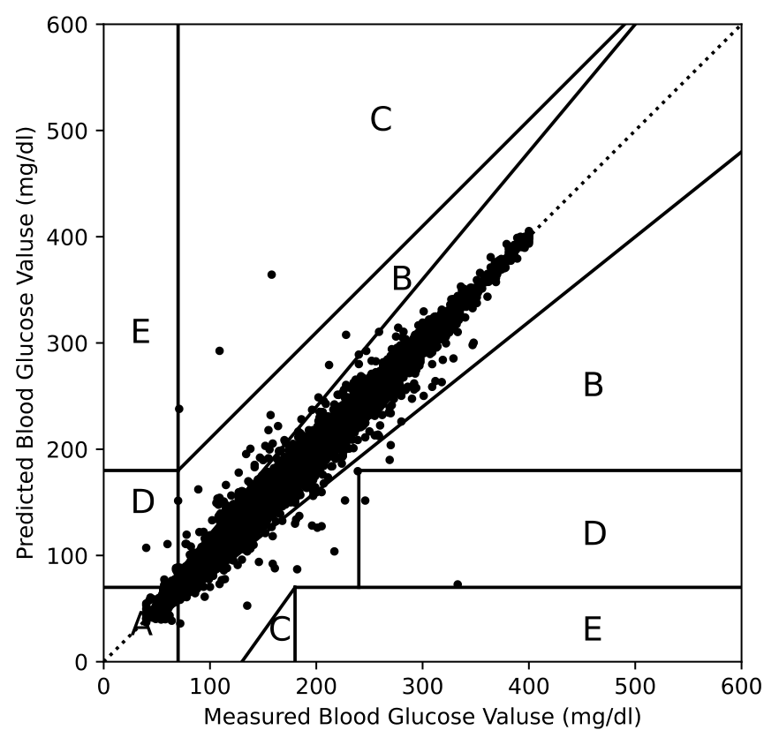
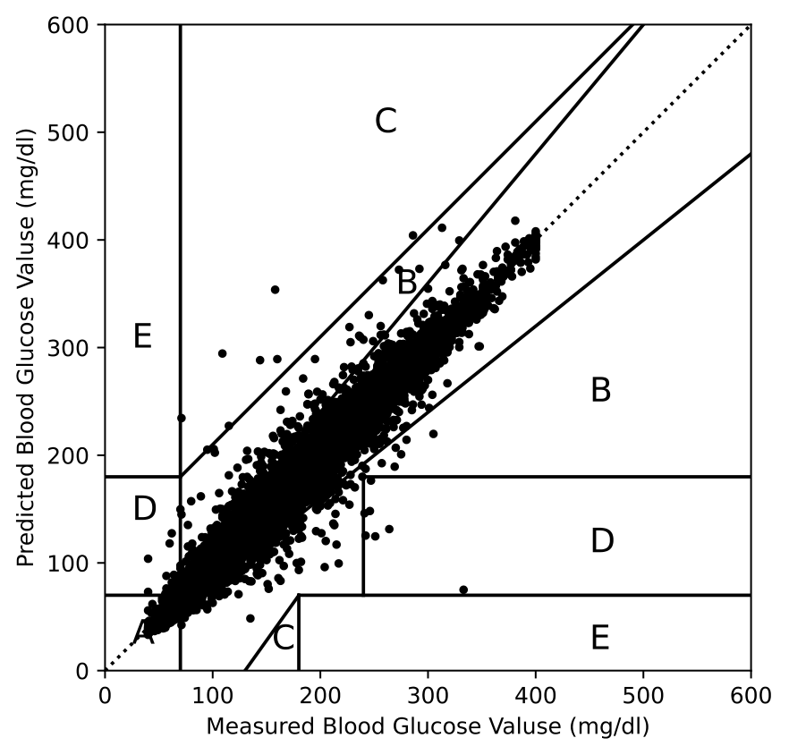
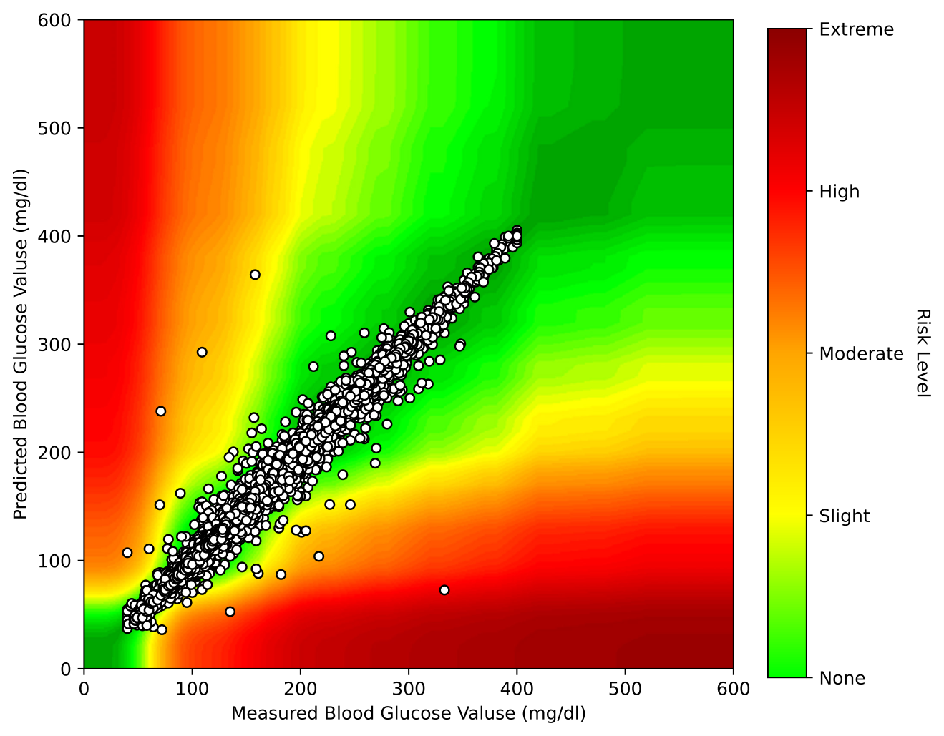
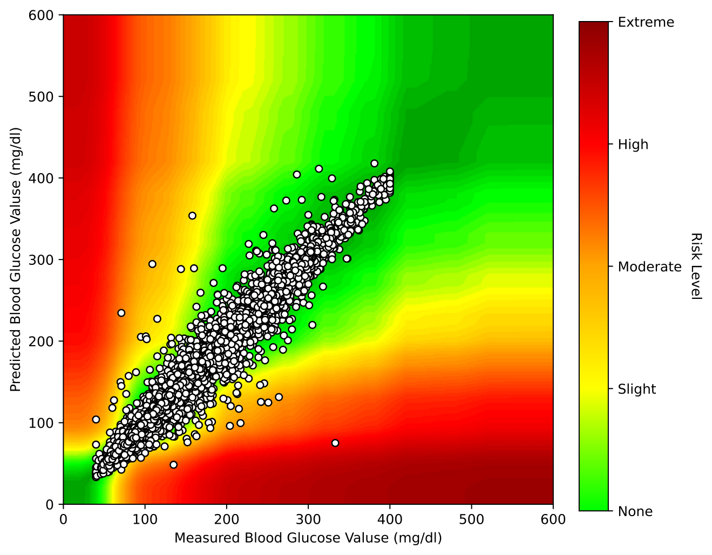
CLINICAL ERROR CHARACTERIZATION
Error-grid analysis favors Time-LLM at the cohort level
99.58%
98.43%
97.15%
92.94%
CEG Zone A
CEG Zone A
SEG: None
SEG: None
Time-LLM cohort result
Chronos cohort result
Time-LLM cohort result
Chronos cohort result
Time-LLM
Chronos
Time-LLM
Chronos
Source: DiabLLM cohort-level CEG and SEG tables and figures, OhioT1DM, 30-minute horizon.
Notes:
The error-grid results complement RMSE. Time-LLM places 99.58 percent of cohort predictions in Clarke Zone A and 97.15 percent in the SEG None category, compared with 98.43 and 92.94 percent for Chronos. Use careful language: these are retrospective error-grid outcomes, not proof of safety in insulin dosing or prospective clinical use.

Slide 9
ROBUSTNESS TO SENSOR IMPERFECTIONS
Denoising recovers much of the accuracy lost to corrupted CGM
Corruption model
gain + offset
calibration bias
AR(1) noise
temporally correlated
dropout blocks
~10% cumulative duration
45-minute horizon
Denoised Time-LLM is ~26% lower RMSE than denoised Chronos.
Source: DiabLLM robustness table. Cohort averages across 12 OhioT1DM patients; mean RMSE in mg/dL.
Notes:
Sensor corruption is simulated with gain and offset calibration error, correlated noise, and missing blocks. The autoencoder reduces average RMSE from 51.067 to 19.119 for Time-LLM and from 47.453 to 25.963 for Chronos. This supports preprocessing as a robustness strategy under the tested simulation, but it does not demonstrate robustness to every real sensor failure mode.

Slide 10
GENERALIZATION ACROSS INDIVIDUALS
Cross-patient transfer shows limited degradation in the tested pairs
What transfers?
Temporal glucose patterns
Training on patient 584 slightly improves Chronos performance on patient 570.
Boundary
Only two patients are used in this transfer matrix; population-level generalization is unresolved.
Source: DiabLLM cross-patient performance table. Labels are Train ID to Test ID; metric is RMSE in mg/dL.
Notes:
This experiment uses patients 570 and 584 to create a compact transfer matrix. Time-LLM changes from 16.81 to 17.63 on patient 570 depending on the training patient, and from 27.23 to 26.63 on patient 584. Chronos also shows small changes. The result is encouraging for transfer, but the scope is only two patients and should not be generalized to a new clinical population.

Slide 11
KNOWLEDGE DISTILLATION
Distillation preserves BERT-level accuracy with a 45M-parameter student
TEACHER
STUDENT
Across 12 patients
Time-LLM
BERT
Time-LLM
TinyBERT
0.014
mg/dL lower average RMSE
12 layers • 768 dimensions
ground truth + teacher alignment
4 layers • 312 dimensions
No significance claim; predictive performance is effectively matched at the reported precision.
RMSE 20.967
RMSE 20.953
Ldistill = alpha LGT + beta LMSE
Sources: DiabLLM distillation methodology and 12-patient distillation results table.
Notes:
The teacher is Time-LLM BERT and the student is TinyBERT. Training combines ground-truth regression loss with alignment to the teacher predictions. Across all twelve patients, average RMSE is 20.967 for the teacher and 20.953 for the distilled model. Do not call the student statistically better; the supported conclusion is preservation of accuracy at the reported precision.

Slide 12
INFERENCE EFFICIENCY
Compression changes the deployment trade-off by orders of magnitude
Parameters
Disk size
Latency
6.3x
6.3x
163.8x
smaller
smaller
lower
282.4M to 45.0M
1077 MB to 172 MB
208218.8 ms to 1271.3 ms
BERT teacher to distilled TinyBERT
BERT teacher to distilled TinyBERT
BERT teacher to distilled TinyBERT
Boundary: measured under simulated constraints; physical edge-device deployment was not performed.
Source: DiabLLM inference metrics and limitations. Ratios calculated from reported values.
Notes:
This is the practical payoff of distillation. The student has about one sixth the parameters and disk size, and the reported latency is roughly one hundred sixty-four times lower. However, repeat the boundary on the slide: these measurements substantiate feasibility under simulated constraints; the study did not deploy on a physical pump, phone, or Raspberry Pi.

Slide 13
VALIDITY BOUNDARIES
Strong retrospective results do not establish clinical readiness
DATA
INPUTS
ROBUSTNESS
Two small public T1DM cohorts
CGM-only forecasting
Simulated corruption
Broader demographic and device diversity remains untested.
Meals, insulin, activity, and uncertainty are not integrated.
Real sensor failures may differ from the gain, noise, and dropout model.
DEPLOYMENT
CLINICAL
TRUST
No physical edge validation
Retrospective error grids
Complex model representations
Latency, energy, thermals, and reliability require hardware testing.
No prospective trial or closed-loop dosing evaluation.
Interpretability, bias, privacy, and calibration remain open.
The next milestone is not another retrospective benchmark - it is prospective, calibrated, hardware-validated evidence.
Source: DiabLLM discussion, limitations, and conclusion.
Notes:
Be explicit about what the paper does not establish. The datasets are small, CGM is the only input, corruption is simulated, edge results are not from physical deployment, and error grids are retrospective. The proper next step is prospective validation with calibrated uncertainty and real hardware, not simply another leaderboard comparison.

Slide 14
DiabLLM establishes a promising but bounded foundation
1
2
3
Architecture
Evidence
Practicality
Chronos tokenizes glucose; Time-LLM reprograms patches for a frozen LLM.
Fine-tuned Time-LLM leads the tested 30-minute benchmark and error-grid outcomes.
Denoising and distillation address corrupted inputs and computational cost.
Next: prospective evaluation • uncertainty calibration • multimodal context • real edge hardware
Amirhossein Mahmoudi | github.com/ammahmoudi/diab-llm
Notes:
Close with three takeaways. First, the two architectures solve the continuous-to-language interface differently. Second, adaptation makes Time-LLM the strongest tested model in this protocol. Third, denoising and distillation move the system toward practical use. The remaining work is prospective clinical and hardware validation.

Slide 15
SELECTED SOURCES
References and discussion
DiabLLM
A. Mahmoudi et al., IEEE Journal of Biomedical and Health Informatics, vol. 30, no. 8, 2026.
doi.org/10.1109/JBHI.2026.3658588
Time-LLM
M. Jin et al., Time Series Forecasting by Reprogramming Large Language Models, ICLR 2024.
arXiv:2310.01728
Chronos
A. F. Ansari et al., Learning the Language of Time Series, TMLR 2024.
arXiv:2403.07815
OhioT1DM
C. Marling and R. Bunescu, The OhioT1DM Dataset for Blood Glucose Level Prediction: Update 2020.
CEUR-WS Vol. 2675
D1NAMO
F. Dubosson et al., The D1NAMO dataset: a multi-modal dataset for research on non-invasive type 1 diabetes management.
Informatics in Medicine Unlocked, 2018
Code
Official DiabLLM implementation and experiment pipeline.
github.com/ammahmoudi/diab-llm
Questions?
Notes:
Use this as the discussion slide. If asked about architecture details, return to slide three. If asked about clinical readiness, return to slide thirteen. If asked about model efficiency, distinguish training time, the reported inference benchmark, and actual hardware deployment.

